Slide 1
ETSI-Alignment Architecture and Roadmaps - ETSI NFV Workshop Presentation
February 18, 2020
Participating Companies & Contacts:
Ericsson: Byung-Woo Jun
Verizon: Fred Oliveira
Samsung: Miroslaw Medrek
CMCC: Yan Yang, Yuanhong Deng
ZTE: Hongyu Zhao
Intel: Haibin Huang, Alex Vul
Huawei: Seshu Kumar
Andrew Lamb, Eoin Hanan, Gareth Roper,
Michael Morris, Ronan Kenny, Waqas Ikram
Orchestration Scenarios (a.k.a. ETSI-Alignment) Task Force weekly meeting,
Weekly meeting: Mondays at 12PM UTC, 5AM PT, 8AM ET, 2PM CET, 5:30PM India, 8PM China.https://zoom.us/j/722438866
Dial In: +16699006833,,722438866# US (San Jose) +16465588656,,722438866# US (New York)
ETSI Alignment Support, https://wiki.onap.org/display/DW/ETSI+Alignment+Support

Slide 2
Agenda
1 | ETSI MANO and ONAP ETSI Alignment Landscape
2 | ONAP ETSI-Alignment Overall Architecture
3 | ONAP ETSI Catalog Management Component
4 | ONAP ETSI VNF Package Management Interfaces
5 | SOL003 Adapter Architecture & Use Cases
6 | SOL005 Adapter Architecture & Use Cases
7 | SOL002 Adapter Architecture & Use Cases
8 | Communication Security between ONAP and SVNFM/NFVO *
9 | CNF Support *
10 | Hierarchical ETSI-Based Orchestration *
11 | ETSI-Alignment Requirements and Roadmaps
* Challenges for future releases

Slide 3
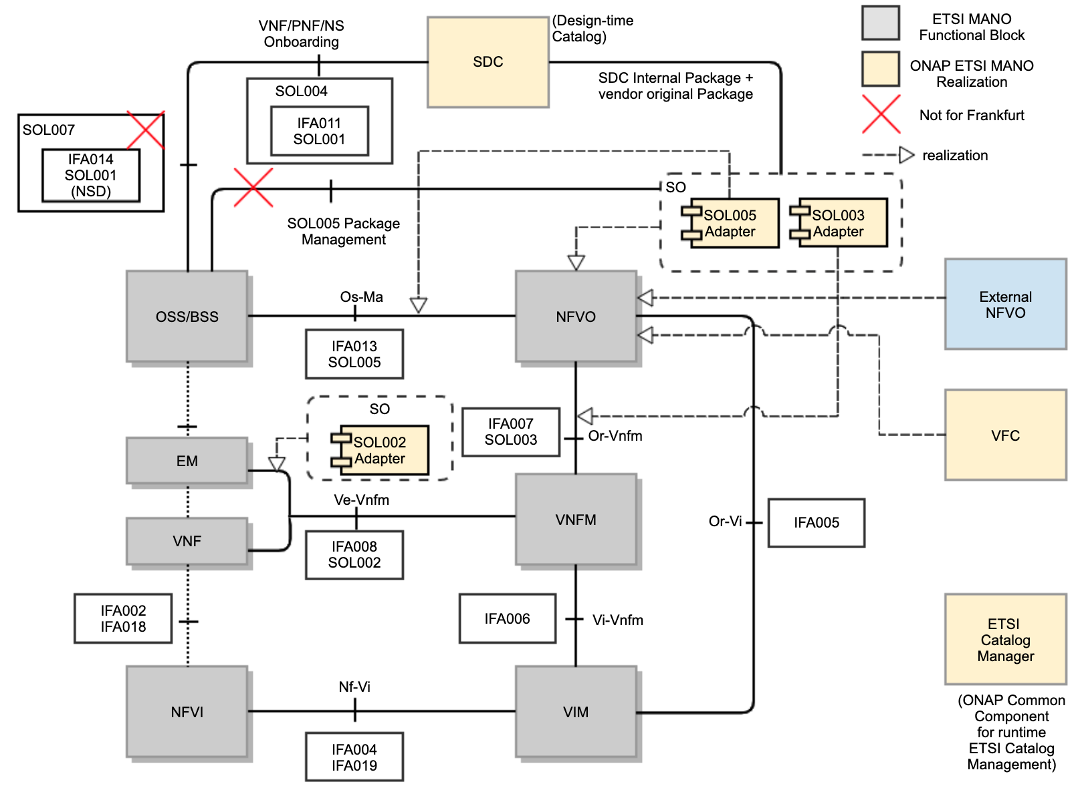
ETSI MANO and ONAP ETSI Alignment Landscape
As part of aligning ONAP to ETSI MANO, ONAP supports ETSI standards for packaging, LCM operations, security for managing VNF, PNF and NS.
For packaging, the SOL004 standard is used for the VNF and PNF package, and the SOL007 standard will be used for the NS package
SOL007 support is not for Frankfurt
SOL005 Package onboarding to SO is not for Frankfurt
VNF, PNF and NS descriptors are described by the SOL001 standard.
The SOL003 standard is used for VNF LCM, Package Management and Monitoring.
The SOL005 standard is used for NS LCM and VNF Package Management and Monitoring.
The SOL002 standard is used for VNF/VNFC-level EM triggered scenarios (LCM, Fault, Performance, Configuration).
ETSI Package and communication security are supported.
ONAP components target realization of ETSI MANO
SDC realizes SOL004 and SOL007 package onboarding, design and distribution functionalities.
SOL007 package onboarding is not for Frankfurt
External NFVO and VFC realize the NFVO functionalities.
SOL003 Adapter realizes the Or-Vnfm (SOL003) interface.
SOL005 Adapter realizes the Os-Ma (SOL005) interface.
SOL002 Adapter realizes the Ve-Vnfm (SOL002) interface.
ETSI Catalog Manager provides ETSI Catalog/Package management.

Slide 4
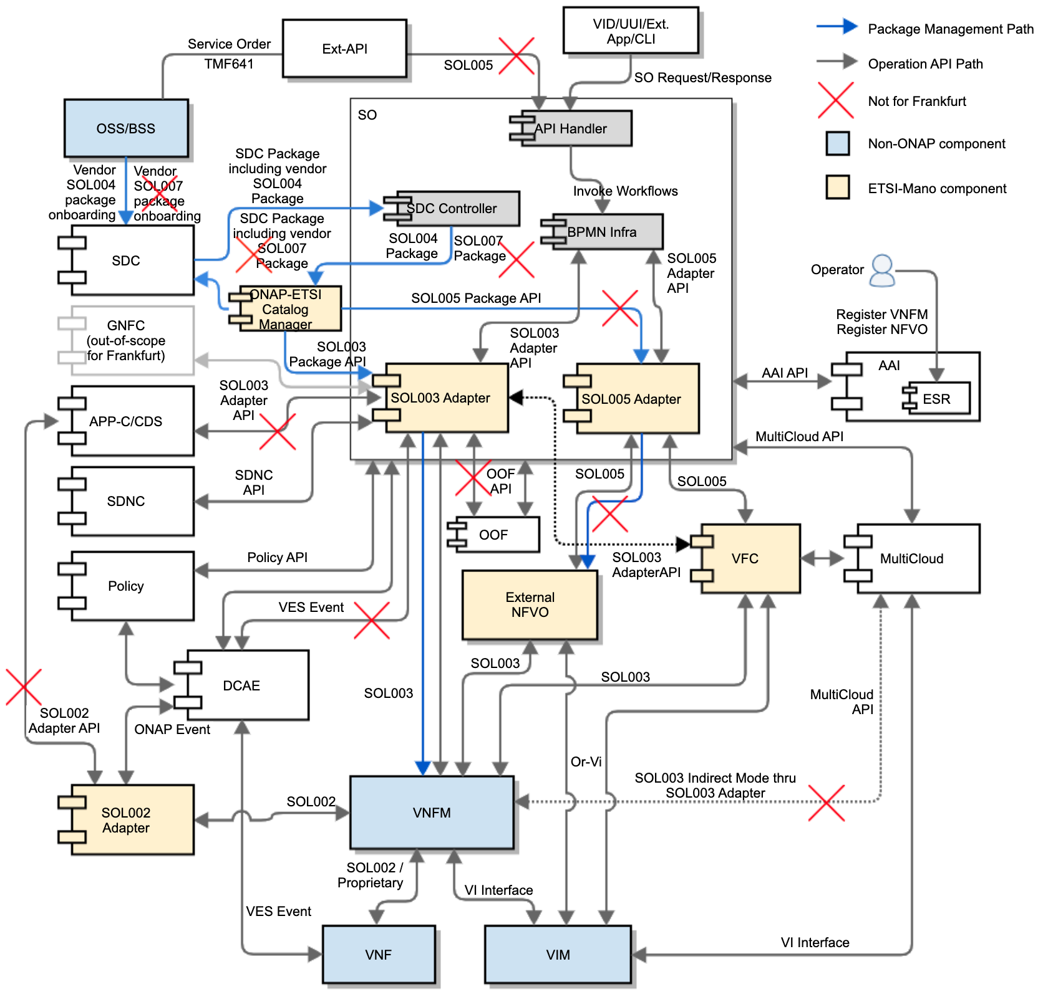
ONAP ETSI-Alignment Overall Target Architecture
ONAP will be aligned with ETSI standards: SOL004, SOL007, SOL001, SOL003, SOL005, SOL002
SDC supports SOL004 Package Onboarding
SDC CSAR embeds the vendor SOL004 package in an ONAP VNF package
SOL007 package support will not be in Frankfurt
SO (SDC Controller) gets an SDC package notification and queries for the SDC package including the vendor SOL004 package (SOL007 is not for Frankfurt)
SDC Controller invokes the ETSI Catalog Manager (common component) to store vendor packages, by passing the CSAR Id
ONAP-ETSI Catalog Manager queries for the SDC CSAR and stores the SOL004 vendor packages in its database
SOL003 Adapter supports VNF package management and LCM
SOL003 Adapter forwards VNF packages to VNFM over SOL003 Package Management Interface
SOL005 Adapter queries for NS/PNF descriptors & VNF packages (not for Frankfurt)
SOL005 Adapter forwards NS/PNF descriptors & VNF packages to External NFVO (not for Frankfurt)
SOL003 Adapter supports SOL003 Operations
SOL005 Adapter supports SOL005 Operations
SOL002 Adapter supports SOL002 Operations
Note: SOL003/SOL005/SOL002 Adapters will be designed to leverage common functionalities such as: Security, HPA, AAI, Policy, ETSI Catalog Manager
SOL005 Northbound support is not for Frankfurt
SOL003/SOL002 Adapter NBI GNFC-Ready & APPC/CDS are not for Frankfurt
SOL003 Adapter DCAE event mapping is not for Frankfurt
2
1
3
4
5
7
10
8
9
6
11
For more architecture and design details: https://wiki.onap.org/display/DW/ETSI+Alignment+Support

Slide 5
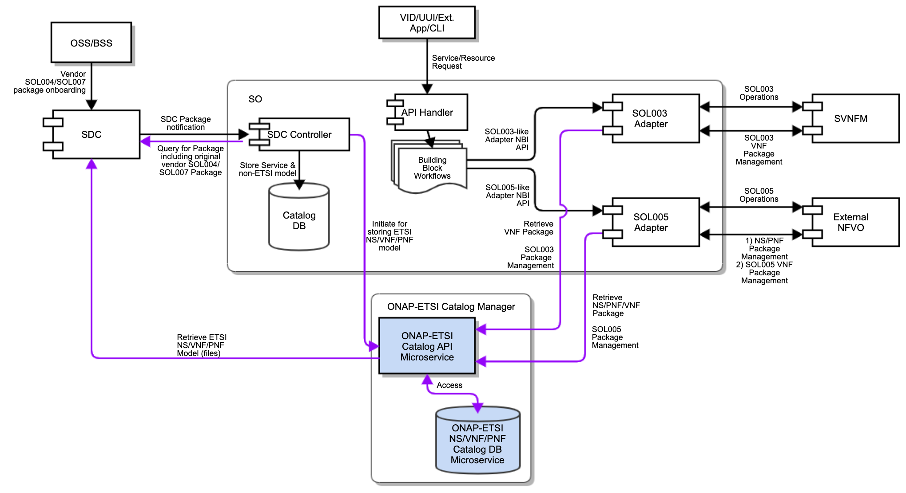
ONAP ETSI Catalog Management Component
CMCC, ZTE
ETSI Catalog Manager is a common component.
SO (SDC Controller) queries the package from SDC.
SO invokes ETSI Catalog Manager for storing vendor packages to the ETSI Catalog database
ONAP-ETSI Catalog Manager APIs are used for storage of vendor packages, by passing the SDC CSAR ID
ETSI Catalog Manager will retrieve the CSAR file(s) from SDC and extract embedded ETSI package(s)
For Non-ETSI models (Service + Non-ETSI Resource, metadata), SO uses the existing SO embedded Catalog DB
ONAP-ETSI Catalog Manager provides package management APIs and Catalog Database
Catalog_NSPackage
Catalog_VNFPackage
Catalog_PNFPackage
Catalog_SoftwareImageModel
SOL003/SOL005 Adapter accesses ONAP-ETSI Catalog through ONAP-ETSI Catalog Manager APIs
SOL003 Adapter provides SOL003 Package Management APIs to SVNFM
SOL005 Adapter provides SOL005 Package Management APIs to External NFVO (not for Frankfurt)
Note: PNF package distribution use cases are under discussion.
Parses the service csar
Get resource CSARs (CSAR ID)
Invoke ETSI Catalog Manager to store vendor packages in ETSI Catalog
VNF first and then NS
6
1
2.A
3
pass SDC CSAR id
7
5
2.B
4
The Catalog Manager is a common component (part of Modelling project)
It could be evolved to store other catalogs.
ETSI Catalog Documentation Wiki page: https://wiki.onap.org/display/DW/Etsicatalog+Documentation

Slide 6
ONAP ETSI VNF Package Management Interfaces
CMCC, Ericsson, ZTE
SO SDC Controller -> ETSI Catalog Manager
/api/catalog/v1/vnfpackages/{csarId}
pass the sdc csar uuid
ETSI Catalog Manager -> SDC
/sdc/v1/catalog/{assetType}/{uuid}/toscalModel (download CSAR)
/sdc/v1/catalog/{assetType}/{uuid}/metadata
ETSI Catalog Manager
Get an SDC CSAR and extract the vendor SOL004 package from the ONBOARDED_PACKAGE artifact directory
Store the vendor SOL004 package into the ETSI Catalog Manager DB
ETSI Catalog Manager provides package management APIs and package management notification APIs based on the SOL003 specification.
etsicatalog.swagger.json
etsicatalog.swagger.notification.json
For more details, see https://wiki.onap.org/display/DW/ETSI+Catalog+Management > SO ETSI Catalog DB Support for NS, VNF and PNF packages
SOL003 Adapter provides notification APIs for ETSI Catalog Manager and invokes the package management APIs.
SOL003 Adapter and SVNFM use SOL003 package management APIs.
SVNFM implements VNF package management notification API
ONAP
SDC package
notification
Get an SDC
CSAR uuid
SOL003-VNFPackageManagementNotification-API.json
(from forge.etsi.org)
SDC
SO SDC
Controller
Query for
SDC package
etsicatalogswagger.notification.json
1
notification
/api/catalog/v1/vnfpackages/{csarId}
5
SOL003
Adapter
6
SVNFM
SO
trigger
Subscription,
Query,
Read VNFD,
Fetch VNF pkg,
Fetch VNF artifacts
Notification
Mapping
etsicatalogswagger.json
Subscription,
Query,
Read VNFD,
Fetch VNF pkg,
Fetch VNF artifacts
2
3
/sdc/v1/catalog/{assetType}/{uuid}/toscalModel
ETSI
Catalog Manager
4
/sdc/v1/catalog/{assetType}/{uuid}/metadata
SOL003-VNFPackageManagement-API.json
(from forge.etsi.org)
https://{serverRoot}/sdc/v1/catalog/{assetType}
etsicatalogswagger.json
swagger
Interface Provider Endpoint
Note: Direct interface between SDC and ETSI Catalog Manager is under discussion.
ETSI Catalog Documentation Wiki page: https://wiki.onap.org/display/DW/Etsicatalog+Documentation
ETSI Catalog Management Wiki Page: https://wiki.onap.org/display/DW/ETSI+Catalog+Management

Slide 7
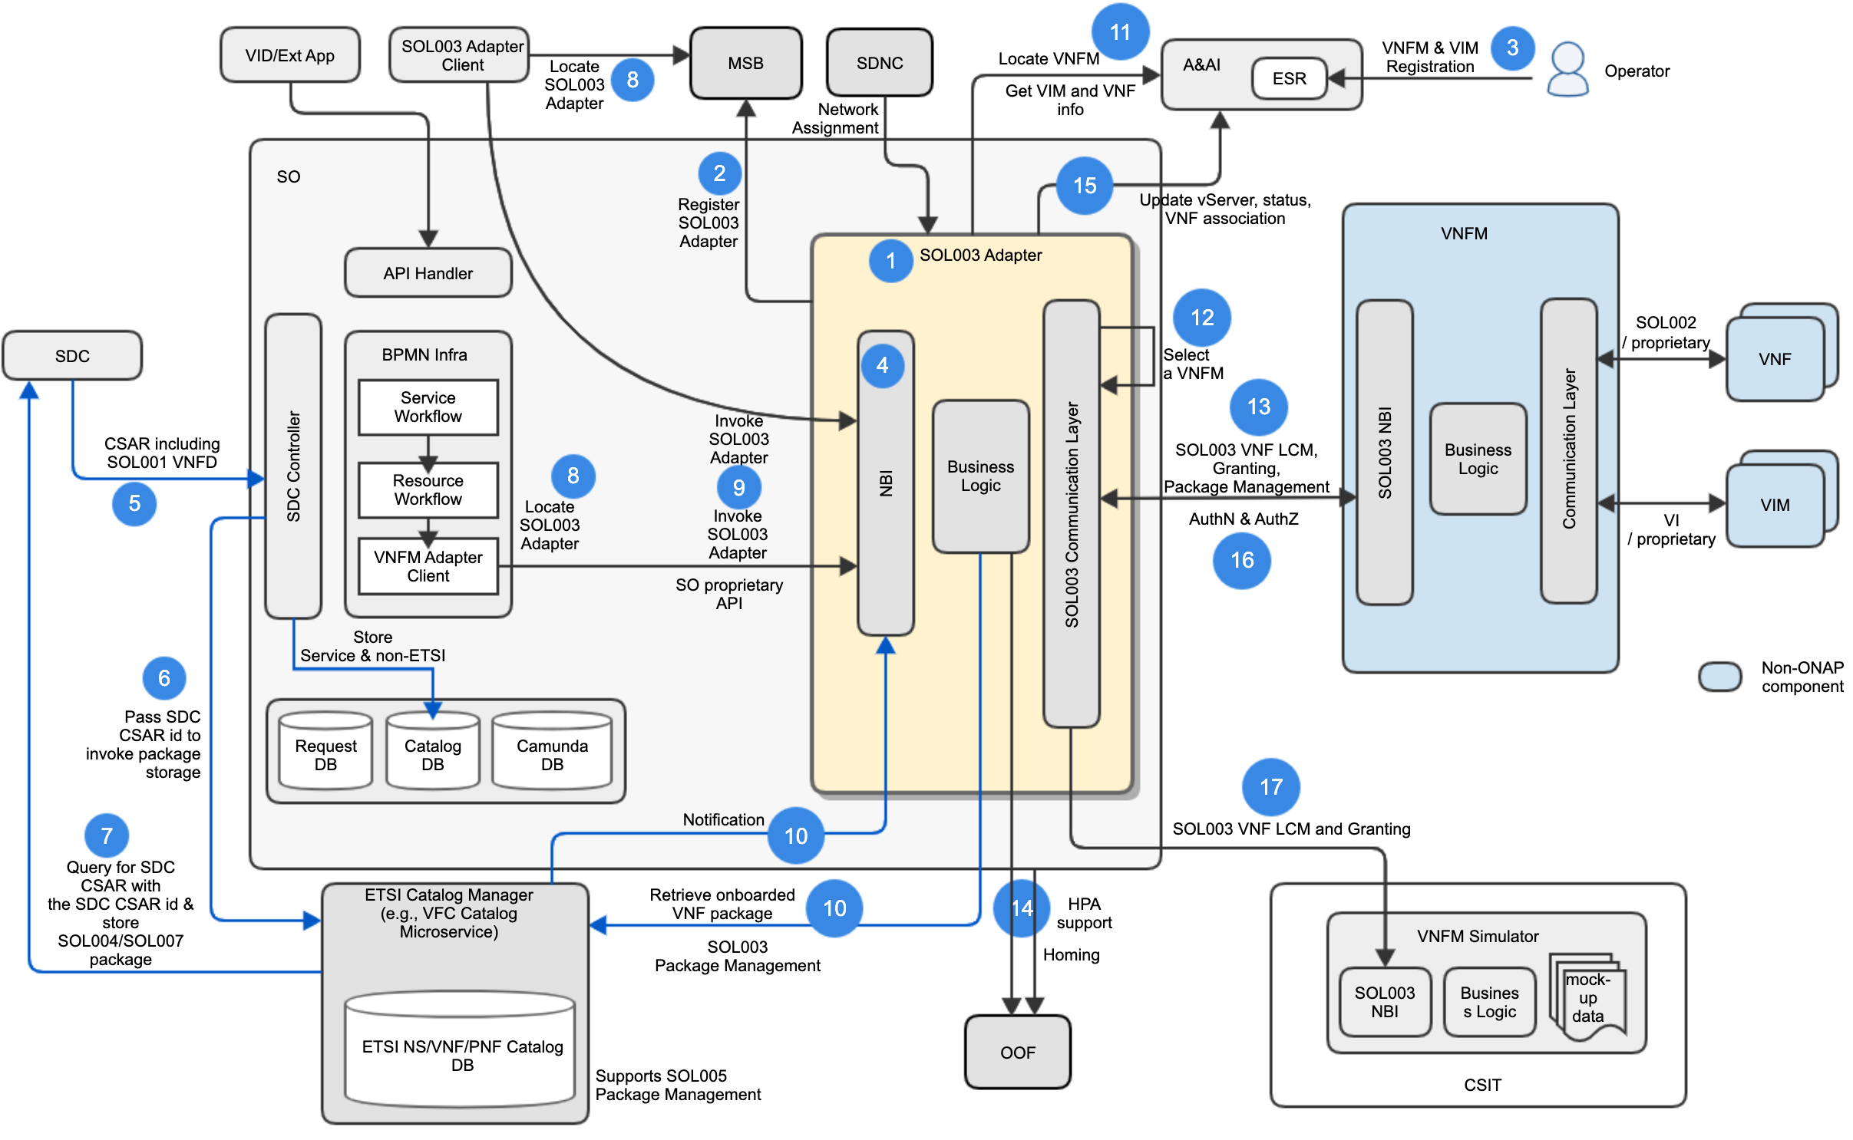
SOL003 Adapter Architecture & Use Cases
Ericsson
SOL003 Adapter is a SO microservice component
SOL003 Adapter is registered to MSB.
Operator registers VNFM and VIM to ESR in AAI.
SOL003 Adapter exposes its NBI to any SOL003 Adapter client in ONAP (not for Frankfurt)
Interfaces will be refactored to be generic to allow access by other ONAP components.
The NBI will be enhanced for additional SOL003 operation support
SDC distributes SDC packages including the vendor original SOL004 (VNF and PNF) and SOL007 (NS) packages – SOL007 is not for Frankfurt
SO (SDC Controller) passes the SDC CSAR ID to ETSI Catalog Manager to invoke storage
ETSI Catalog Manager queries for SDC CSAR with the SDC CSAR id & store SOL004 package.
SO (BPMN) and the SOL003 Adapter client locates SOL003 Adapter.
SO (BPMN) and the SOL003 Adapter client invokes SOL003 Adapter.
SOL003 Adapter gets Notification & VNF package from Catalog Manager.
SOL003 Adapter gets available VNFM locations (endpoints) and gets VIM and VNF Info.
SOL003 Adapter selects a VNFM, based on a VNFM locating mechanism.
SOL003 Adapter and SVNFM supports SOL003 VNF LCM, granting and package management operations.
SOL003 Adapter supports HPA-based Granting, leveraging OOF.
SOL003 Adapter updates vServer, status and VNF association in AAI
SOL003 Adapter and SVNFM support authentication and authorization (AAF, and vendor AA mechanism) – partially for Frankfurt.
For integration testing, the VNFM Simulator is used.

Slide 8
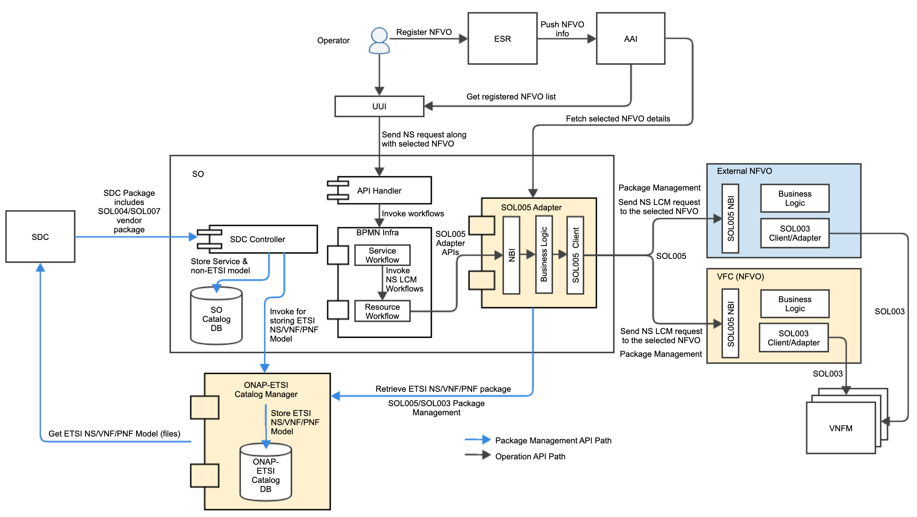
SOL005 Adapter Architecture & Use Cases
Verizon
SOL005 Adapter is a Microservice that will make connections between SO and VF-C/External NFVO through SOL005 standards.
SOL005 Adapter will support the following APIs in Frankfurt
NS LCM : Create NS, Delete NS, Get NS, Instantiate NS, Terminate NS
Package/Descriptor Management is not for Frankfurt
NSD Management : Subscribe, Query Subscribe Information, Terminate Subscription, Notify
VNF Package Management : Fetch VNF Package Artifacts, Subscribe, Query Subscription Information, Terminate Subscription
Use Cases
Operator registers NFVO to ONAP via ESR
ESR registration entities are pushed to AAI
Operator sends NS requests from UUI along with selected NFVO details
SOL005 Adapter fetches NFVO details from AAI
SOL005 Adapter sends the requests to NFVO
For Frankfurt, supports only NS LCM, not
Package Management
Package
management

Slide 9
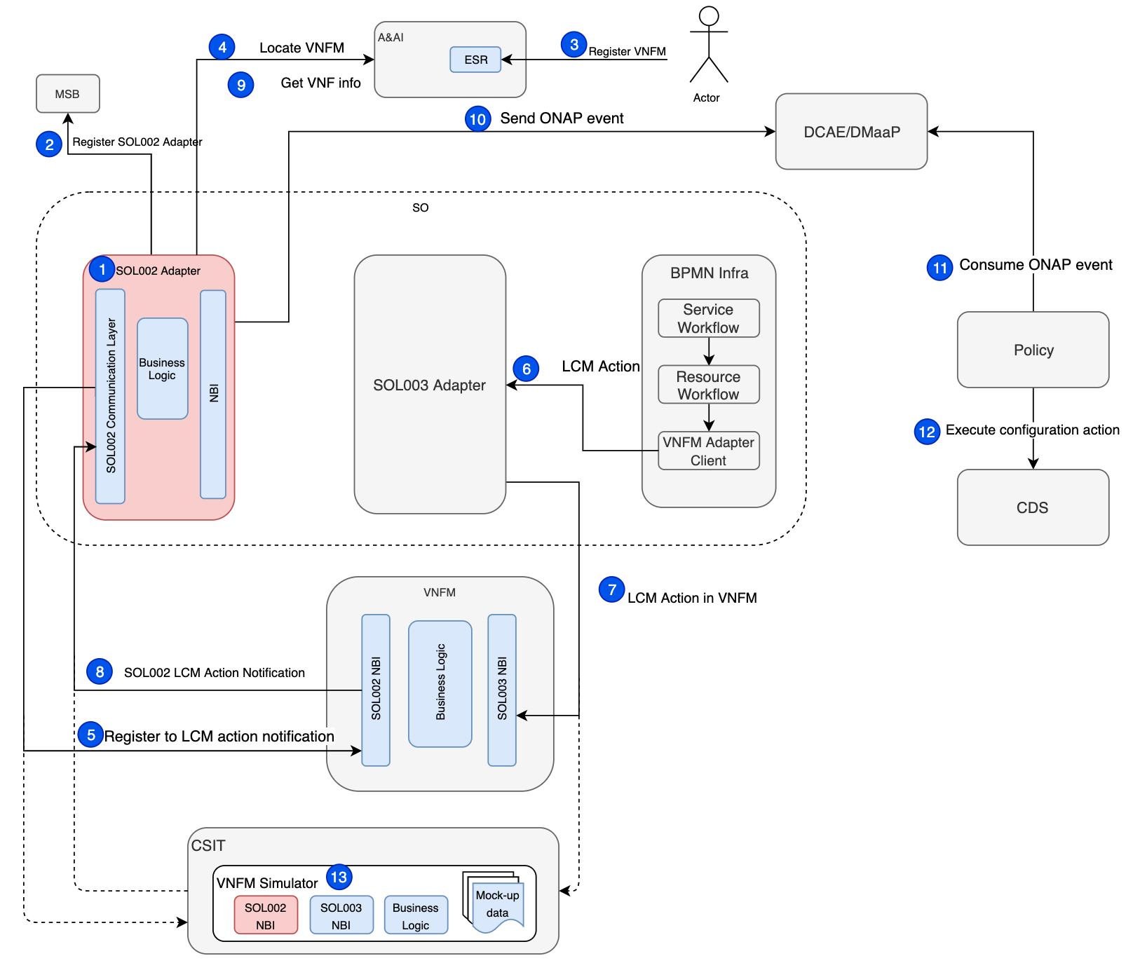
SOL002 Adapter Architecture & Use Cases
Samsung
SOL002 Adapter will be a SO micro-service that makes connections between VNFM and ONAP (as Element Manager) through ETSI defined Ve-Vnfm interface
SOL002 Adapter registers to MSB
Operator registers VNFMs to ESR in AAI
SOL002 Adapter locates VNFMs via AAI
SOL002 Adapter subscribes for VNFM notifications
SOL002 Adapter receives calls from VNFM
SOL002 Adapter gets VNF info from AAI
SOL002 Adapter sends ONAP events to DCAE/DMaaP
VNFM Simulator will be enhanced to interact with the SOL002 Adapter for SOL002 use case testing
Use Case for Frankfurt
SOL002 Adapter subscribes and consumes VNF LCM notifications from VNFM

Slide 10
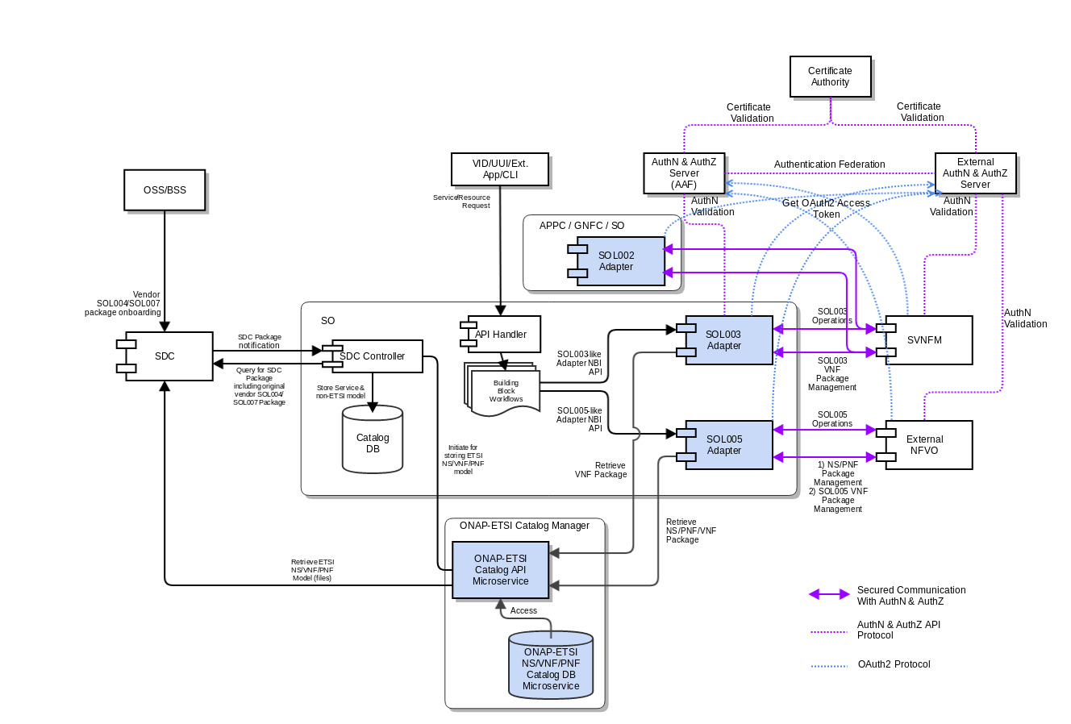
Communication Security between ONAP and SVNFM/NFVO (Challenge)
SOL003/SOL005/SOL002 Adapters will communicate with the SVNFM/NFVO via secured HTTPS protocol with authentication and authorization.
SOL003/005 API call security needs to conform to OAuth2
SOL003/005 Notification call security needs to conform to OAuith2 or HTTP Basic authorization (user/pass)
SOL003/005 Adapters will leverage the AAF security mechanism (as authorization server)
Currently, SOL003 Adapter supports one-way and two-way AA.
SOL002 Adapter will use OAuth2 Token-based authentication
SVNFM/NFVO will be allowed to have their own security mechanisms based on their security requirements but is required to support OAuth2 and HTTP Basic Authentication.
Authentication Federation between the Adapters and the SVNFM/NFVO is under discussion.
Some vendors prefer SAML-based federation
AAF Authentication and External Authentication Server will exchange authentication tokens, based on federation configuration. It depends on AAF.
In the Frankfurt release, the authentication federation may not be supported.
Note 1: All SO external interfaces for other ONAP components (e.g., SDC, ONAP-ETSI Catalog Manager, VID, AAI, SDNC, OOF) will be secured in the Frankfurt release by leveraging AAF.
Note 2: SOL002 Adapter will also leverage the AAF security mechanism and will support OAuth2 and HTTP Basic.
Note 3: More communication Security use cases are under discussion.

Slide 11
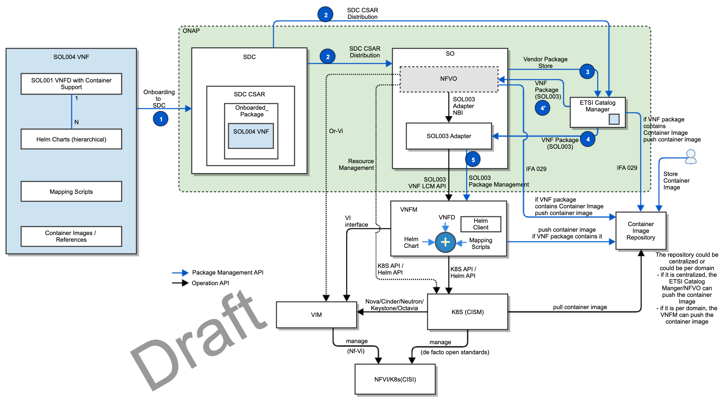
CNF Support (Challenge)
Hybrid orchestration templates – TOSCA VNFD and Helm Charts (MCIO)
TOSCA VNFD drives the interaction between NFVO and VNFM and NS/VNF LCMs
Helm Charts are included as a binary archive in the VNF package, and are consumed by VNFM
Container images are either included in the VNF package or referenced in the descriptors (URL to CIR)
If the VNF package includes Container images, NFVO/ETSI Catalog Manager uploads them to the CIR
Otherwise, operators store Container images to the CIR
Parameter mapping from Or-Vnfm (SOL003) incoming information to Helm input parameters
Resource Mapping between resources in TOSCA VNFD and K8S resources described in Helm chart (for granting between VNFM and NFVO)
Mapping the LCM operations to HELM commands (VNFM behavior triggered on Or-Vnfm), etc.
VNFM-K8S communication prefers Helm APIs to lower level K8S APIs
K8S-VIM communication uses de facto open source standards (Nova/Cinder/Neutron/Keystone/Octavia)
CISM-CIS communication uses de facto open source standards
The above diagram is a draft, based on a CNF PoC and IFA 029. It will be refined by conforming to the coming ETSI CNF standards.
If the vendor VNFM has CNF capabilities, SO will leverage it through the SOL003 Adapter. Otherwise, SO/NFVO could invoke K8S API/Helm API towards K8S (TBD)

Slide 12
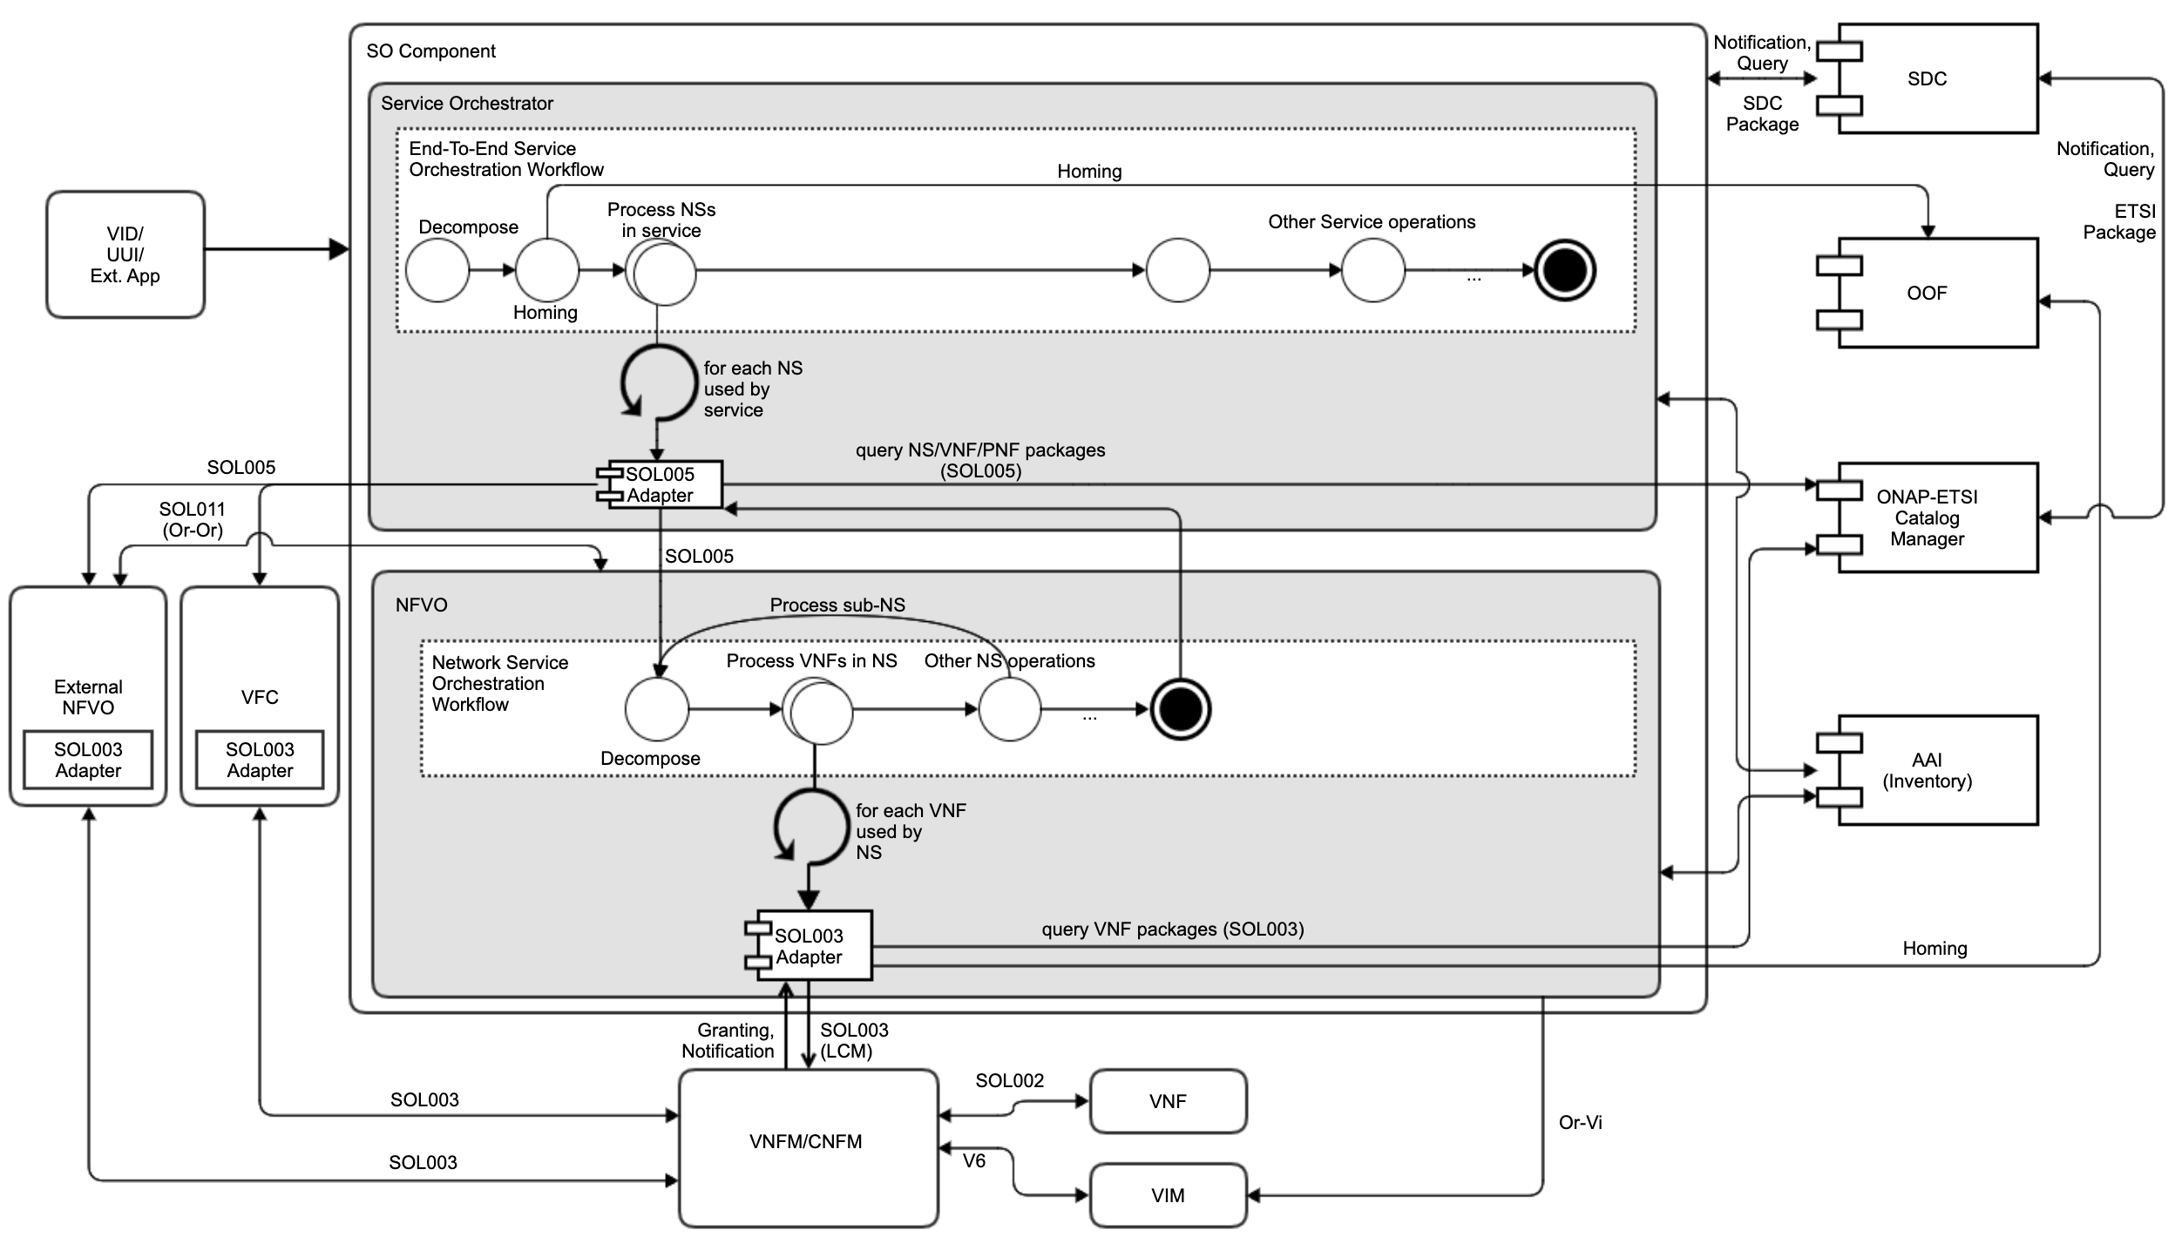
Hierarchical ETSI-based Orchestration (Challenge)
The diagram depicts the orchestration functional blocks
It is an ETSI-based hierarchical orchestration concept, to facilitate ONAP orchestration adoption by operators who have their own NFVOs and/or VNFMs
E2E, NS, VNF, CNF orchestration by leveraging ETSI standards
Working with the existing VFC and external NFVOs
Leveraging the common ETSI Catalog Manager
Leveraging the common OOF for homing
Possible ONAP SO embedded NFVO block
Handle NS LCM Orchestration
Take over Granting and Package Management from the SOL003 Adapter
Support SOL005 Northbound Interface
Support Or-Vi Indirect Resource control for VIM
Possibly, interface with other peer NFVOs (Or-Or)

Slide 13
ETSI-Alignment Requirements & Roadmaps
Dublin | El Alto | Frankfurt Support | Guilin Proposals | Future Topics
ETSI SOL 2.5.1 support SOL003 Adapter Create VNF Instantiate VNF Terminate VNF Delete VNF Subscription Notification Granting SO ETSI VNF BB Workflows VNFM Simulator in the SO project SDC SOL004 PNF onboarding | ETSI SOL 2.5.1 support CSIT (test automation) for SOL003 Adapter SOL003 Adapter Bug fixes Communication security between SOL003 Adapter and SVNFM HTTPS support SpringBoot-based authentication VNFM Simulator migration to the Integration Test project SDC SOL004 VNF and PNF onboarding | ETSI SOL 2.5.1 support SO & SOL003 Adapter enhancements SO SOL004 and SOL001 package storage/retrieval support leveraging ETSI Catalog Manager SOL003-based package management API support SOL003 VNF LCM Operations ETSI Catalog Manager Storing vendor ETSI packages Providing ETSI package APIs to the SOL003/SOL005 Adapters Software Image delivery SOL005 Adapter for Create NS Instantiate NS Terminate NS Delete NS SOL002 Adapter VNF LCM notification AAF-based HTTPS and Authentication – partial OAuth2 support | ETSI SOL 2.7.1 support SDC enhancements SOL007 NS package onboarding SOL001 NSD and VNFD mapping to SDC AID DM SOL003 Adapter enhancements and additional SOL003 operations support SOL003 NBI enhancements for GNFC-ready VNF Query VNF Modify (ModifyVnfInfo) VNF Heal Policy-based Scaling (VNF-level and/or VF-Module-level) SOL003 LCN and translation into DCAE events (FM/PM) High Availability and Fault-Tolerant Granting with HPA via OOF OOF VNF-level Homing Request Support CNF support Model-Driven Orchestration leveraging, Puccini? CDS integration? SOL005 Northbound Interface support SOL005 Adapter enhancements ETSI Package Management Security Additional NS LCM FM/PM Configuration OAuth2-based authentication support between SOL002/SOL003/SOL005 Adapters and SVNFM/NFVO | SDC SOL007 Design and generation of SOL004/SOL007 packages ETSI-based VNF software upgrade SOL011 Or-Or interface to support multi-domain orchestration. ONAP SO embedded NFVO for hierarchical orchestration, as one of the NFVO options – see the hierarchical orchestration section Move package management, Granting, Software-Image handling from SOL003 Adapter to NFVO NS LCM orchestration support
✔
✔

Slide 14
Q & A
CNF spec? IFA029? IFA040?
Or-Vi SOL Spec?
Modeling direction for GVNFM?
VNFD representation for Cloud Native?
Hybrid Modelling for CNF? It is the current assumption
Indirect mode of resource management?
Is the forge.etsi.org swagger official?
VNF Indicator?
ONAP SDC ETSI NS, VNF and PNG package onboarding & modelling?
SDC ETSI package handling?
Common TOSCA parser?
FM/PM conversion into VES event and interaction with DCAE and Policy?
Q & A
Challenges
Recommendations

Slide 15
References
ETSI Alignment Support, https://wiki.onap.org/display/DW/ETSI+Alignment+Support
ETSI Package Management, https://wiki.onap.org/display/DW/ETSI+Package+Management
ETSI Catalog Management, https://wiki.onap.org/display/DW/ETSI+Catalog+Management
Communication Security, https://wiki.onap.org/display/DW/Communication+Security
SOL003 Adapter, https://wiki.onap.org/display/DW/SOL003+Adapter
SOL005 Adapter, https://wiki.onap.org/display/DW/SOL005+Adapter
SOL002 Adapter, https://wiki.onap.org/display/DW/SOL002+Adapter
SOL003 Adapter APIs, https://wiki.onap.org/display/DW/SO+VNFM+Adapter+APIs
SOL003 Adapter Test Case, https://wiki.onap.org/display/DW/SO+VNFM+Adapter+Test+Case
SOL002 Adapter, https://wiki.onap.org/display/DW/SOL002+Adapter
ETSI Catalog Manager, https://wiki.onap.org/display/DW/Etsicatalog+Documentation
SOL003 Package Management API swagger: https://forge.etsi.org/jenkins/view/All%20jobs/job/NFV%20-%20Network%20Functions%20Virtualisation/job/sol002-sol003-master/42/artifact/build/
Orchestration Scenarios (a.k.a. ETSI-Alignment) Task Force weekly meeting,
Weekly meeting: Mondays at 12PM UTC, 5AM PT, 8AM ET, 2PM CET, 5:30PM India, 8PM China.
https://zoom.us/j/722438866
One tap mobile: +16699006833,,722438866# US (San Jose) +16465588656,,722438866# US (New York)

Slide 16
Thank you!

