Slide 1
ETSI NFV Release 4 status and FEAT17 stage 3 views
ONAP-ETSI NFV Contact Thinh Nguyenphu, Nokia
ONAP
October 14, 2020
source: NFVTSC(20)000069r1

Slide 2
Outline
Release 4:
Work items and features: studies and stage 1&2 perspective
Release 4 progress
Background: FEAT17 and IFA040/036 scope
Identifying elements for potential stage 3
Stage 3 work development formats
Release 4: stage 3 schedule planning (as of Oct. 2020)

Slide 3
Release 4: work items and features: studies and stage 1&2 perspective
Completed: underlined
Ongoing/not fully completed: italics
Evolved: in bold
(**): other normative work is part of evolved work items
NOTE: might not be a full complete list due to lack of space
Status as of Sep. 2020
Network Service LCM and Descriptor
(NFV-IFA013/014/030)
VNF LCM, Packaging and Descriptor
(NFV-IFA007/ 008/011)
Virtualised Resource management
(NFV-IFA005/006)
Multi-site connectivity
(NFV-IFA032)
Metrics and Performance
(NFV-IFA027, NFV-TST008)
NFV-MANO mgmt
(NFV-IFA031)
1) Framework from past releases
Information Modeling
(NFV-IFA015/016/017/024)
4) Carried-over from Rel. 3
2) New features
3) Technical enhancements
MEC in NFV
(**)
Security mgmt
(NFV-IFA026/033, NFV-SEC024)
Multi-tenancy for NFV-MANO
(NFV-EVE018)
Network connectivity integration and operationalization for NFV
(NFV-IFA035/038)
NFV-MANO automation and autonomous networks
(NFV-IFA041)
Security enhancements
(**)
NFV-MANO upgrades
(NFV-REL011)
Licensing mgmt
(NFV-EVE010, NFV-IFA034)
VNF generic OAM functions
(NFV-EVE019)
Specific technical enhancements
(**)
NFV enhancements for 5G
(NFV-IFA037)
Policy models
(NFV-IFA042)
Cloud-native VNFs and container infrastructure mgmt
(NFV-EVE011, NFV-IFA029/036/040, NFV-SEC023, **)
Continuous VNF integration
(**)
SBA for NFV-MANO
(NFV-IFA039)

Slide 4
Release 4: progress
IFA033 was completed and published as v4.1.1.
IFA040 was completed but publication is pending due to normative references to other specifications.
A first drop of publication is planned for Oct/Nov.
It will contain only “part of FEAT17 on Cloud-native VNFs and container infrastructure mgmt.”
To cover IFA040, IFA010 and IFA011, and to be published as v4.1.1.
IFA040: CISM and CIR container workload service interfaces.
IFA010: functional requirements for NFV-MANO, including CISM and CIR.
IFA011: VNFD modelling to support container-based VNF.
Parts of FEAT17 and rest of features are progressing, but not as fast as it was initially planned.
IFA036 on “container cluster management” expected to be completed for drop #2 (Jan. 2021).
By default other features are postponed to the drop 2.
Informative studies of Release 4 features should be completed by drop #2.

Slide 5
Background: FEAT17 and IFA040/036 scope
The feature addresses NFV Architecture support for VNFs which follow “cloud-native” design principles.
The feature enhances: - NFV-MANO capabilities to support container technologies based on DGR/NFV-IFA029. - NFV-MANO capabilities for container management and orchestration. - Information model for containerized VNFs both using bare metal or nested virtualization technologies.

Slide 6
Identifying elements for potential stage 3
Elements to consider for stage 3 work related to FEAT17 might include:
Interfaces/APIs
New APIs to address stage 2 requirements (e.g., IFA040, IFA036).
Extending existing NFV-MANO APIs (e.g., SOL002, SOL003, SOL005, SOL009, etc.).
NFV descriptors:
VNFD (likely extensions to SOL001 and SOL006).
NSD (likely extensions to SOL001 and SOL006).
Artifacts (e.g., packaging):
Defining composition of the VNF Package for containerized VNF (likely extensions to SOL004).
NFV-MANO procedures:
Procedures with references to ETSI NFV defined protocol and data models (likely extensions to SOL016).

Slide 7
Stage 3 work development formats
Different formats to proceed with stage 3 relevant work:
Format #1: ETSI NFV creates is own stage 3 solution specification. This can include both to extend existing documents or create new documents.
Format #2: ETSI NFV endorses a stage 3 solution specified by some other organization.
Sub-option 2.a: with profiling, i.e., specifying what and how to use the other organization’s specification.
Sub-option 2.b: without profiling, i.e., just adopting other organization’s specification without indicating specific use.
Format #3: ETSI NFV stops related work at stage 2 level and no further stage 3 work is delivered. Assumes a de-facto standard is already available, but ETSI NFV does not endorse it specifically.

Slide 8
Possible formats on stage 3 work
The scope of FEAT17 is very broad, involving descriptors, new APIs, other NFV-MANO APIs, etc. A single format might not be possible. Considering the options in the formats of stage 3 outputs, ETSI NFV needs to perform further analysis of such formats and their feasibility to start actual stage 3 specification work.
DISCLAIMER: These views are neither thoroughly discussed in the ETSI NFV, nor endorsed, and just provide an indication/example.
Area | Sub-area | Format
Interfaces / APIs | New APIs. | Format #2 or Format #1
 | Extending existing NFV-MANO APIs. | Format #1
NFV descriptors | VNFD and NSD. | Format #1
Artifacts | Composition of VNF Package | Format #1
 | Defining the composition and model of MCIOP | Format #2 or Format #1
Procedures | NFV-MANO procedures | Format #1

Slide 9
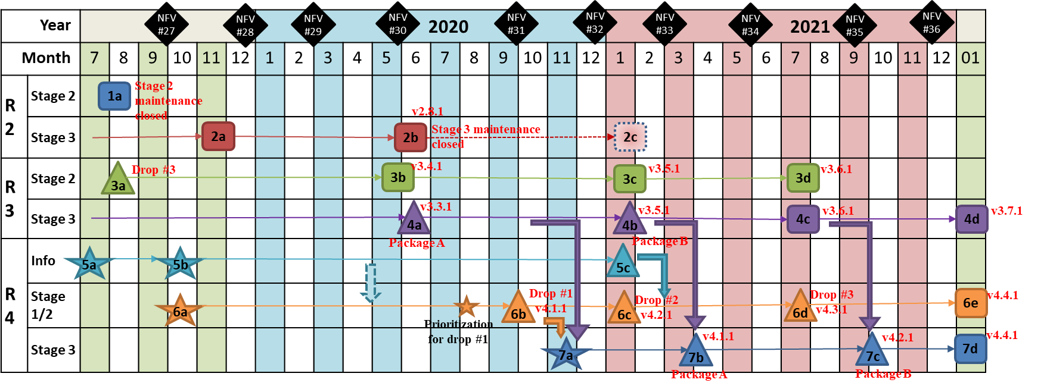
Release 4: stage 3 schedule planning (as of Oct. 2020)
DISCLAIMER: This schedule is tentative, and pending on approval and start of associated and required work items. Purpose is only to provide an indicative timeline for Release 4 stage 3 work. Other items or information shall be disregarded.
7b: Delivery of first versions of Rel. 4 stage 3 on selected documents around 1Q of 2021.
7a: Possible start of Rel. 4 stage 3 before end of 2020 on selected set of documents.

Slide 10
More information
NFV Technology Page (information / main website) http://www.etsi.org/nfv
NFV Portal (working area) http://portal.etsi.org/nfv
NFV Proofs of Concept (information) http://www.etsi.org/nfv-poc
NFV Plugtest (information & registration) http://www.etsi.org/nfvplugtest
Open Area and other tools:
Published Documents
Working Drafts
Issue tracker
Releases documentation: Rel. 2 Description, Rel. 3 Description, Rel. Definition
Detailed Release 3 and 4 specification progress wiki pages:
OpenAPI representations of GS NFV-SOL NFV-MANO APIs
GS NFV-SOL 001/006 supporting files on ETSI Forge
GS NFV-TST 010 Robot API test files
NFV Releases
Issue Tracker
NFV
http://nfvwiki.etsi.org/index.php?title=NFV_Issue_Tracker
NFV
! !

